Slide 1

Beyond ideation: creating a lasting culture of innovation
Rob Galbraith, CPCU, CLU, ChFC
Founder and CEO, Forestview Insights
Alamo Chapter CPCU Society
October 18, 2023

Slide 2
Key questions to cover
Why innovate?
Why do organizations focus too much on the here and now?
Why is linking innovation to strategic objectives so critical?
What are the different types of innovation?
How can we create a lasting culture of innovation?

Slide 3
Key questions to cover
Why innovate?
Why do organizations focus too much on the here and now?
Why is linking innovation to strategic objectives so critical?
What are the different types of innovation?
How can we create a lasting culture of innovation?

Slide 4

What is our business case to innovate?
What is the appetite for innovation in our organization?
Who are the primary change agents? Top-down, bottom-up, or outside?
How successful have our innovation efforts been to date? (failure rate)
How well do we capture good ideas and turn them into reality?
“Innovation distinguishes between a leader and a follower.”
-Steve Jobs

Slide 5
What are the barriers to innovation?
Short answer: insurance is super complicated!
Insurance is a financial instrument and legal contract all rolled into one
Carriers do not know “true” cost of goods sold until after product is sold
Misaligned goals and incentives among a myriad of stakeholders
Benefits of innovation are unknown, while drawbacks are evident
Common reasons cited based on survey of experts:
Complexity
Capital requirements
Regulation / legal / judicial environment
Low return on equity
Lack of transparency to consumers
Need for trust

Slide 6
Key questions to cover
Why innovate?
Why do organizations focus too much on the here and now?
Why is linking innovation to strategic objectives so critical?
What are the different types of innovation?
How can we create a lasting culture of innovation?

Slide 7

You get what you measure – and incentivize
Most organizations use key metrics or KPIs as a proxy to achieve strategic objectives
Bonuses and incentives are tied to the metrics
Taking big risks is generally NOT rewarded!
  ”Why are all insurance firms conservative? Because the risk takers went insolvent”
  “No one gets fired for implementing Guidewire”
Incumbent advantages: recurring revenues, regulatory compliance, scale, distribution, data
Startup advantages: less technical debt, narrow focus, ability to experiment and iterate, access to capital through VCs, urgency

Slide 8

The gate agent problem

Slide 9
What is insurtech?
Technology has been part of the insurance industry for centuries, but the modern era begins with the adoption of mainframe computers in the 1970s
A precise definition of the concept of insurtech is elusive but generally incorporates the following elements:
  emerging technologies not previously widespread in use,
  deployed in uses that are novel as opposed to new, and that
  provide disproportionate benefits to customers and/or stakeholders as opposed to incremental gains
Common theme: leveraging innovation to future-proof your business
Notes:
3 minutes

Slide 10
Key questions to cover
Why innovate?
Why do organizations focus too much on the here and now?
Why is linking innovation to strategic objectives so critical?
What are the different types of innovation?
How can we create a lasting culture of innovation?

Slide 11


Image vs. reality in innovation
C-suite
Vision
Strategic fit
PR opportunity
Ambitious
Agility
“Flavor of the month”
Directionless
Competing priorities
No true ownership
Lack of clarity
On the ground

Slide 12
The promise and the reality of most innovation efforts
What innovation claimed they delivered
What the business unit received

Slide 13

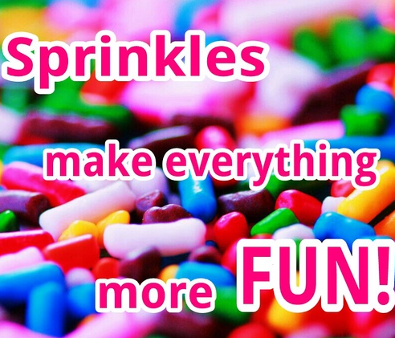

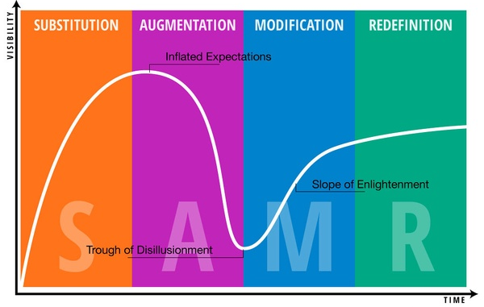
The 4 most common mistakes in innovation
Fear Of Missing Out
Sprinkle Strategy
Pet Projects
Hype Cycle

Slide 14
Avoiding “innovation fatigue”
Too often, companies implement a successful new innovation…
and then stop for “a breather”…
and stop “playing” entirely
By tying innovation directly to your strategic roadmap, the goal is to avoid reinventing innovation efforts with each change in leadership at the top
Photo: Sean M. Haffey (Getty)

Slide 15

Innovation as a discipline, not a side show
Take the long view
Start with why: look out 10 years like VCs
Identify key megatrends & their impacts
Formulate your strategic roadmap & revise
Document & revisit your assumptions – be “precisely wrong but directionally correct”
Instill innovation as a process
Ideation is only the first step on the journey
Map ideas back to strategic roadmap & risk
Focus on the novel, not merely the new
Develop learning objectives & expect failure
Small wins should fund big swings

Slide 16
Mega-trend categories for insurance sector
Demographic, societal and behavioral trends
The nature of risk
Economic, financial and political trends
Technological trends
Notes:
The nature of risk
Demographics trends, societal and behavioral changes
Economic, financial and political changes
Technological changes

Slide 17

Show your work
Document your “worldly” assumptions
Identify ”known unknowns” = RISK
Design experiments with learning objectives as candidates for innovation
Decide on prioritization & methods
Revisit your “world view” every 6 months
Develop a communication plan & execute

Slide 18
Key questions to cover
Why innovate?
Why do organizations focus too much on the here and now?
Why is linking innovation to strategic objectives so critical?
What are the different types of innovation?
How can we create a lasting culture of innovation?

Slide 19
Offensive vs. defensive innovation
Offensive innovation
Potentially “game changing”
Provides competitive advantage
Stretches your organization
Requires vision & dedication
Makes people uncomfortable
High risk vs. high rewards
Needs disciplined process with focus on experimentation
Defensive innovation
Incremental / adjacent possible
Avoid falling behind
Less risky & reward is clearer
Ideally should be “quick wins”
Led by subject matter experts
Look to reap benefits that can “fund” riskier initiatives
Allows you to “earn your keep”

Slide 20
Top-down vs. bottom-up innovation
Top-down innovation
Use for “Henry Ford” innovation
Involves more C-suite direction
Must haves:
  Clear learning objectives
  Accountability
  Protection of resources
  Safety to speak up
  Cognitive diversity
Target small success, then scale
Bottom-up innovation
Support for “intrapreneurship”
Solicit ideas from everyone
Product and process focus
Encourage business challenges
Set up “feedback as a feature”
Foster “ownership mentality”
Hold hack-a-thons & other events
Provide tangible rewards

Slide 21
Key questions to cover
Why innovate?
Why do organizations focus too much on the here and now?
Why is linking innovation to strategic objectives so critical?
What are the different types of innovation?
How can we create a lasting culture of innovation?

Slide 22
Prepare for success by planning to be operational
Idea becomes plan?
Plan becomes reality?
Or somewhere at the many points in between?

Slide 23
My lessons learned from on-the-ground experience
Innovation is a team effort that requires cognitive diversity to be successful
Psychological safety is a prerequisite – it is OK to ”row in a different direction”
Innovation is a newer discipline, but no less important than claims, UW, etc.
Transparency is often cited and rarely achieved – avoid “whisper campaigns”
Technology is just one part of innovative solutions, but gets all the attention
Ideation is just one step in the innovation process, but gets all the attention
Innovation requires unwavering commitment + humbleness to fail & learn

Slide 24
Innovation self-reflection questions
How well does our current culture support innovation?
Where are our biggest “pinch points” and ”gravity issues”?
How do we measure the success of innovation efforts?
How well do we maintain our enthusiasm over time?

Slide 25





Thank youI
Contact info for Rob:
Email: rob@endofinsurance.com
@robgalb
Search “Rob Galbraith insurance”
Search “Rob Galbraith”
mostinterestingmanininsurance

