Slide 1





Lawrence V. Adam III, CFA, CIMA®, CFP® Chief Investment Officer
1

Slide 2
1 Introduction │Setting Our Sights on The Future, Not Looking Back
4Q23 MARKET OUTLOOK: SAILING IN STRANGE SEAS
Economy │Navigating by the Stars Under Cloudy Skies as We Approach a Recession
Monetary Policy │“Oh Captain My Captain”—Nearing the End of the Tightening Cycle
Politics│Guiding the Path to 2024
Fixed Income │Marco Polo as Lower Interest Rates Remain Elusive
Equities │Earnings the ‘Spinach’ Needed to Fuel the Market Higher
Asset Allocation │Lessons Learned from Jimmy Buffett

Slide 3

INSIGHT:
Experienced sailors know that you cannot look backwards to determine where you are going. Instead, they have to use the tools at their disposal to determine what lies ahead.
1
Introduction
Looking Forward, Not Backwards
BOTTOM LINE:
After record fiscal stimulus, low interest rates and a
solid job market, the winds are shifting for the economy and asset classes. Determining the future will be key for portfolio performance.

Slide 4










THE INVESTMENT STRATEGY BINOCULARS
Real-time Economic Indicators
Historical Analysis Valuations/Fundamentals
Policymaker actions
Low Interest
Rates
Record Fiscal Stimulus
Strong Labor Market
Record Consumer Spending

Slide 5

INSIGHT:
The strength of the consumer has kept the economy afloat to this point. However, cracks are beginning to form as excess savings are depleted and fixed costs surge as a result of rising interest rates.
2
ECONOMY
Navigating by the Stars Under Cloudy Skies
BOTTOM LINE:
Depleted excess savings, combined with credit tightening and job growth slowing, suggests the economy will slide into a mild recession beginning in 1Q24. Despite the slowdown, we expect 2024 GDP to rise 0.4% on an annual basis.

Slide 6
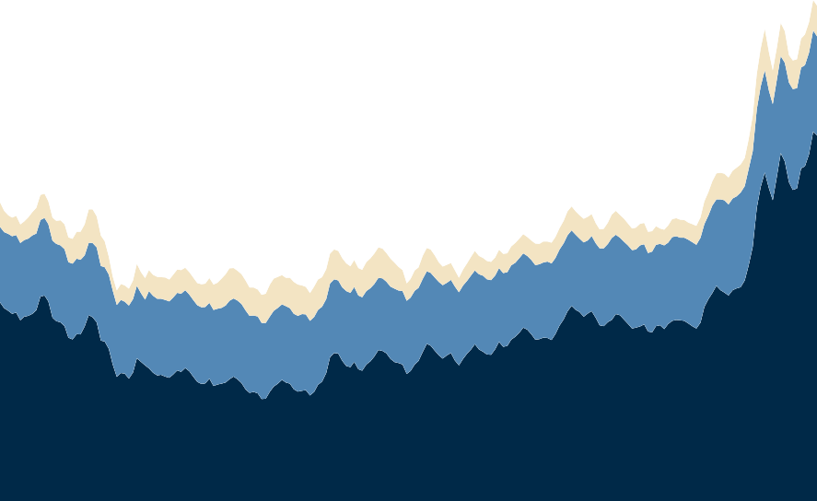
CONSUMER HEADWINDS BUILDING
DEPLETED EXCESS SAVINGS AND RISING EXPENSES WILL WEIGH ON CONSUMER SPENDING
Excess Savings Depleted Surge in Mortgage, Auto and Gas Expenses
2.5
3500
3000
2
+78%
Average Monthly Consumer Expenditure Since Start Of COVID
2500
1.5
2000
1
1500
0.5
1000
500
0
0
-0.5
2006
2009 2012 2015 2018
Average Monthly Consumer Expenditure Mortgage Auto Gas
2021
'20 '21 '22
Accumulated Savings (in $trillions)
Source: FactSet, Data as of 9/30/2023.
'23

Slide 7
HEADWINDS FOR THE ECONOMY
A SLOWING LABOR MARKET COMBINED WITH TIGHTENING LENDING STANDARDS WILL WEIGH ON THE ECONOMY
Job Growth Set to Turn Negative Banks Tightening Lending Standards
1000
100%
More Tightening
80%
800
60%
7.2%
90-Day Credit Card Delinquencies Rose To The Highest Level Since 1Q12
600
40%
20%
400
Job growth is set to turn negative by January 2024
0%
200
-20%
0
-40%
Less Tightening
1996 2000 2004 2008 2012 2016 2020
Net % of Banks Tightening Lending Standards
-60%
-200
'21
'22
'23
'24
Nonfarm Payrolls
Forecast
Recession C&I Loans Consumer Loans - Credit Card
Source: FactSet, Data as of 9/30/2023.

Slide 8




PAST THE SUMMER OF REVENGE TRAVEL
MOMENTUM IN CREDIT CARD SPENDING IS SLOWING AS TRAVEL-RELATED SPENDING SLOWS
Credit Card Spending Losing Momentum
5%
Only 5% Of Consumers Expect To Spend More This Holiday Shopping Season
Travel Spending Starting to Slow
125
120
115
110
105
100
95
33%
33% Of Consumers Expect To Spend Less This Holiday Shopping Season
90
85
2018
2020
Visa Spending Momentum Index
2022
Discretionary Spending Non-Discretionary Spending
Source: FactSet, Data as of 9/30/2023.

Slide 9
A RECESSION FORECAST TO BEGIN IN 1Q24
DESPITE INCREASED CALLS FOR A SOFT LANDING, WE FORECAST A MILD RECESSION TO BEGIN IN 1Q24
Economic Growth Typically Strong Leading into a Recession Recession Forecasted to Start in First Quarter of 2024
12%
10%
8%
6%
4%
2%
0%
-2%
-4%
-6%
-8%
-10%
3.0%
2.4%
2.6%
2.5%
2.0%
1.8%
2.0%
Average: +2.6%
1.5%
1.0%
0.5%
Recession
0.5%
0.0%
Average: -3.5%
-0.5%
-1.0%
-0.8%
-1.5%
-1.2%
1948 1953 1957 1960 1970 1973 1980 1981 1990 2001 2008 2020
Quarter Preceding Start of Recession Quarter of Recession Start
Source: FactSet, Data as of 9/30/2023.
2Q23
3Q23
4Q23
1Q24
2Q24
3Q24
4Q24
Real GDP

Slide 10





WHY A RECESSION IS LIKELY TO BE MILD
WE EXPECT THE UPCOMING RECESSION TO BE MILD IN MAGNITUDE AND DURATION
Expected Recession vs. Historical Averages
+0.4%
2024 US GDP
Forecast
Five Reasons Why We Expect a Mild Recession
Economic Contraction
-0.6%
-2.5%
6 months
10 months
0.5M
3.5M
-3.2%
-18.5%
-0.5%
-24.4%
Average
1
Overall Healthy Consumer—Not Overleveraged Like Prior Cycles
Average Duration
2
Still Healthy Job Market—Job Losses Will be Less than Historical Average
12%
Of Survey Respondents Do Not Expect a Recession Over the Next 12 Months
Jobs Lost
3
Few Excesses in the Economy—No Housing Bubble, No Bloated Inventories
Fixed Investment
4
Solid Government Spending—Likely to Lead to Additional Investment
S&P 500
Earnings
5
‘Rolling Recessions’—Certain Areas of Economy Have Experienced Downturn
Forecast
Source: FactSet, Data as of 9/30/2023.

Slide 11

INSIGHT:
The Fed continues on the path of tightening monetary
3
policy. However moderating inflation and cooling economic activity should allow the Fed to end its tightening cycle in the fourth quarter.
Monetary Policy
“Oh Captain My Captain”
BOTTOM LINE:
We expect inflation to continue to moderate and the US economy to enter a recession in 1Q24. Additionally, we expect one more 25 bp rate hike in November and the Fed to begin cutting rates in mid-2024.

Slide 12
FALLING INFLATION TO ALLEVIATE FED CONCERNS
INFLATION IS LIKELY TO CONTINUE TO MOVE ON A DOWNWARD PATH
Inflation to Roll Over with Slowing Demand
Goods Prices Continue to Decline
8
7
6
5
4
3
2
1
0
-1
-2
1998 2001 2004 2007 2010 2013 2016 2019 2022
6%
4%
Inflation Declines
158 bps
In 12 Months Following Recession Start On Average
2%
0%
-2%
-4%
-6%
Recession
Supply-driven Inflation (headline, y/y) Ambiguous (headline, y/y)
Demand-driven Inflation (headline, y/y)
Source: FactSet, San Francisco Fed, Data as of 9/30/2023.
-8%
2015 2016 2017 2018 2019 2020 2021 2022 2023
Adobe Digital Price Index (%YoY)

Slide 13
FALLING SHELTER PRICES SUPPORTIVE OF MODERATING INFLATION
EASING SHELTER PRICES AND CALENDAR EFFECTS WILL ALSO BE SUPPORTIVE OF MODERATING INFLATION
Shelter Prices Moving Lower
Hotter Months of Last Year Set to Roll Off
14
12
10
8
6
4
2
0
Jul-20 Jan-21 Jul-21 Jan-22 Jul-22 Jan-23 Jul-23
Core CPI Using Rent.com Shelter Data Y/Y % Core CPI Y/Y %
8.50%
10%
9%
8%
7%
7.50%
6.50%
5.50%
6%
5%
4.50%
4%
3.50%
3%
2%
1%
0%
2.50%
1.50%
2018
2019
2020 2021
CPI - Owners Equivalent Rent (%YoY)
2022
2023
Nov '21 Feb '22 May '22 Aug '22 Nov '22 Feb '23 May '23 Aug '23 Nov '23
Actual Forecast
Source: FactSet, Data as of 9/30/2023.

Slide 14
THE ECONOMY REMAINS INTEREST RATE SENSITIVE
THE US ECONOMY IS NOT COMPLETELY IMMUNE TO FED TIGHTENING
Revolving Credit at All-Time Highs Combined With Higher Credit Card Rates
Housing/Auto Affordability Plummet
Government Interest Expense Surging
(Quarterly Annualized)
1,300
230
210
190
170
150
130
110
90
70
50
1981 1987 1993 1999 2005 2011 2017 2023
30
1,000
20.7%
Average Credit Card Interest Rate – Highest Since At Least 1994
32
1,250
34
800
1,200
36
1,150
600
38
1,100
40
400
1,050
42
44
200
1,000
46
0
950
'48 '56 '64 '72 '80 '88 '96 '04 '12 '20
Government Interest Expenditure
2018
2019 2020 2021
Revolving Credit (in Trillion $)
2022
NAR Housing Affordability Index (LHS)
Cox Automotive Vehicle Affordability Index (RHS, in Reverse)
Source: FactSet, Data as of 9/30/2023.

Slide 15
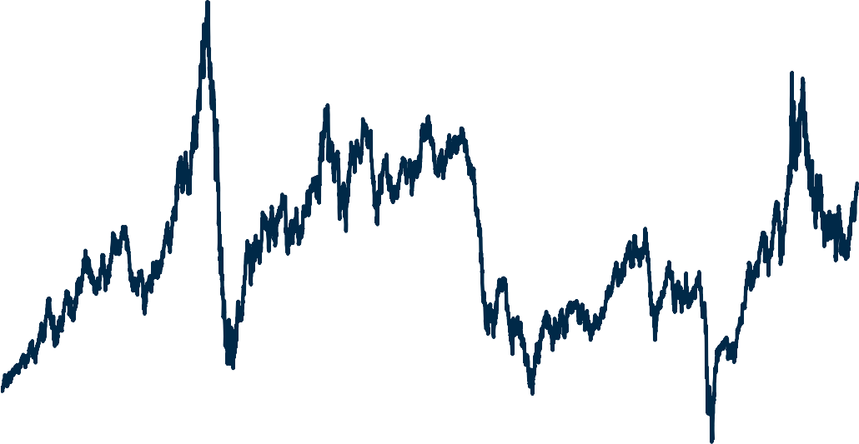
THE FED IS NEARING THE TIGHTENING CYCLE FINISH LINE
WE EXPECT ONE MORE RATE HIKE IN 4Q BEFORE THE FED CUTS RATES IN MID-2024
Fed Funds Forecast
Rising Oil Prices a Key Risk
6%
160
10%
8%
6%
4%
2%
0%
-2%
2018 2019 2020 2021 2022 2023
All Other Items Energy & Commodities (ex. Food & Energy)
5%
140
120
4%
7 Months
Average Time Between Last Fed Rate Hike & First Rate Cut
100
3%
80
2%
60
1%
40
20
0%
'21
'22 '23
RJ Federal Funds Target Rate Forecast Market Implied (October 6, 2023)
'24
0
2003
2007
2011 2015
Crude Oil - Price
2019
2023
Source: FactSet, Data as of 10/6/2023.

Slide 16

INSIGHT:
The 2024 presidential election is a little more than a year away. With two unpopular candidates in the lead, the economy will be a driving factor in choosing the eventual
winner.
4
Politics
Guiding the Path to 2024
BOTTOM LINE:
A lot can change between now and November 2024; however, history has shown that a recession in the 24 months leading up to the election has been a headwind for the incumbent.

Slide 17


















WASHINGTON COMPOSITION
GOVERNMENT COMPOSITION HAS SHIFTED IN EIGHT OF THE LAST NINE ELECTIONS
2005 | 2007 | 2009 | 2011 | 2013 | 2015 | 2017 | 2019 | 2021 | 2023
President | President | President | President | President | President | President | President | President | President
House | House | House | House | House | House | House | House | House | House
Senate | Senate | Senate | Senate | Senate | Senate | Senate | Senate | Senate | Senate
Source: FactSet, Strategas Research Partners, Data as of 9/30/2023.

Slide 18
THE ECONOMY IS A MAJOR DRIVER OF ELECTION OUTCOMES
A POTENTIAL RECESSION WILL BE A KEY STORY IN THE 2024 ELECTION
Two Unpopular Candidates
Walking the Recession Plank
“It’s the Economy Stupid!”
5
3
President | Recession? | Reelected? |  | President | Recession? | Reelected?
Obama | No | Yes |  | Trump | Yes | No
Bush II | No | Yes |  | Bush I | Yes | No
Clinton | No | Yes |  | Carter | Yes | No
Reagan | No | Yes |  | Ford | Yes | No
Nixon | No | Yes |  | Hoover | Yes | No
LBJ | No | Yes |  | Taft | Yes | No
Eisenhower | No | Yes
Truman | No | Yes
FDR | No | Yes
FDR | No | Yes
FDR | No | Yes
Wilson | No | Yes
Food Prices
91%
0
-5
Gas/Energy Prices
87%
-10
-8
-10
-11
-11
Incomes of Americans
75%
-15
-13
-14
-15
-16
-18
State of Economy
74%
-20
-19
-19-19
-25
-23
12/22
Unemployment Rate
57%
10/20
11/21
3/22 8/22
4/23
8/23
Net Favorability
Biden Trump
Source: FactSet, Data as of 9/26/2023.
0% 20% 40% 60% 80% 100%
% of Americans that View These as Poor/Not so Good
Source: FactSet, Strategas Research, Data as of 9/26/2023. Recessions are counted if they occurred within two years of election.
Source: ABC News/Washington Post, Data as of 9/26/2023.

Slide 19


UPDATE
INSIGHT:
Like Marco Polo, calls for lower interest rates have remained elusive to this point. However, moderating inflation, a mild recession and the end of the Fed’s tightening cycle should push yields lower.
5
Fixed Income
Marco Polo and the Elusive Interest Rate Decline
BOTTOM LINE:
We expect 10-year Treasury yields to decline to 3.50% over the next 12 months. In an environment where growth will be challenged, we prefer to focus on high quality bonds, such as Treasurys and investment grade corporate bonds.

Slide 20
RECORD DRAWDOWN IN THE FIXED INCOME MARKET
THE FIXED INCOME MARKET HAS SEEN A RECORD DRAWDOWN IN MAGNITUDE AND DURATION
Record Drawdown for Fixed Income Market Record Duration of Drawdown in Fixed Income
0%
900
-2%
800
2x longer than the next longest drawdown
-4%
700
-6%
3.50%
2023 Year-End 10-Year Target
600
-8%
-10%
500
-12%
400
-14%
300
-16%
-16%
200
-18%
100
-20%
0
1976
1981
1986
1991 1996 2001 2006
Barclays Agg Drawdowns
2011
2016
2021
1976 1981 1986 1991 1996 2001 2006 2011 2016 2021
Duration of Drawdown (in Trading Days)
Source: FactSet, Data as of 9/30/2023.

Slide 21



MARKET POSITIONING HAS BEEN OFFSIDES ALL YEAR
FIFTH TIME THIS YEAR THAT MARKET COULD BE WRONG FOOTED
Headlines
Performance Since
+10.2%
+33.8%
Investors Have Never Been This Short Bonds
800
600
400
200
0
-200
-400
-600
-800
-1,000
Forbes - January 9, 2023
Yahoo Finance - January 2, 2023
+6.4%
Investors.com - March 20, 2023
+15.3%
2003
2007 2011 2015 2019
CFTC Non-Commercial Net Position in 10-Year Treasury (Long-Short Contracts, in 000s )
2023
Yahoo Finance - May 17, 2023
Source: FactSet, Data as of 9/30/2023.

Slide 22
YIELDS LIKELY TO DECLINE FROM CURRENT LEVELS
SLOWING ECONOMIC ACTIVITY, MODERATING INFLATION, AND THE END OF THE FED TIGHTENING CYCLE SHOULD PUSH YIELDS LOWER
Yields Decline Following Recessions
Yields Decline as Inflation Moderates
Yields Decline Following End of Fed Tightening
0.00
7%
0.0
-0.50
6%
-0.5
5%
-1.00
4%
-1.0
-1.50
3%
-1.5
-2.00
2%
-2.0
1%
-2.50
1981 1990 2001 2007 2020
Change in 10-Year Treasury Yield 6M Prior Until Rec End Average Decline During Last 5 Recessions
0%
-2.5
'03 '05 '07 '09 '11 '13 '15 '17 '19 '21 '23
10-Year Treasury Core CPI %YoY
3M 1Y 2Y 5Y 10Y 30Y
Average Change In Yields 12M After Final Rate Hike (%)
Source: FactSet, Data as of 9/30/2023.

Slide 23
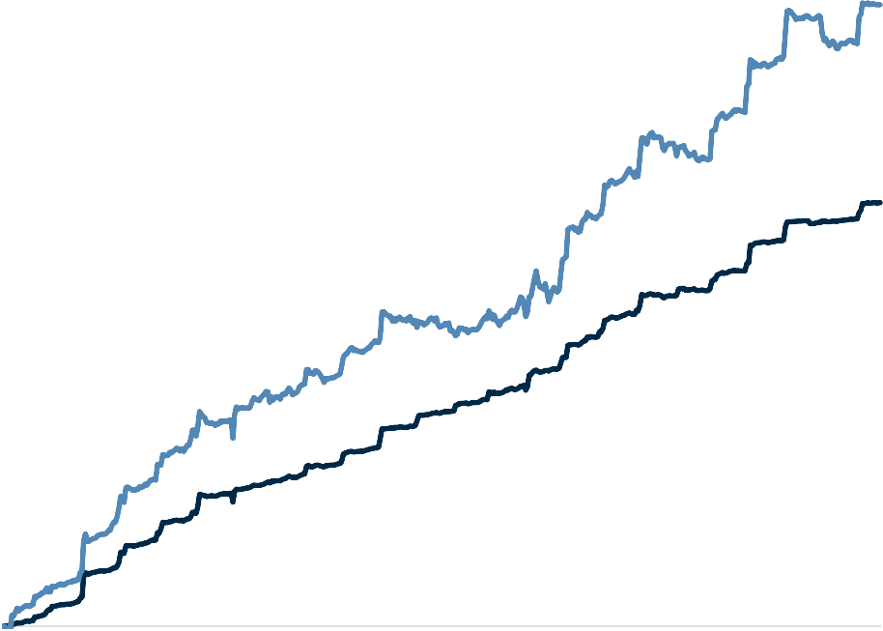
LOOK TO LENGTHEN DURATION
INTEREST RATES ARE LIKELY TO MOVE LOWER OVER THE NEXT TWELVE MONTHS
Yield Decline Following End of Fed Tightening
Brings Elevated Reinvestment Risk
Final Rate
Hike
Look to Lengthen Duration in Current Environment
30.0%
29.6%
0.5
25.0%
0
Total Return Indexed to 100
20.2%
20.0%
-0.5
-1
15.0%
-1.5
10.0%
-2
5.0%
-2.5
0.0%
-6M
-3M
0
+3M
+6M
+9M
+12M
+3M
+6M
+9M
+12M
+15M
+18M
+21M
+24M
2-Year Treasury 10-Year Treasury
Source: FactSet, Data as of 9/25/2023. Data incorporates the last 8 tightening cycles.
2-Year Treasury
10-Year Treasury

Slide 24
HEADWINDS FOR HIGH YIELD BUILDING
HIGH YIELD LIKELY TO BE CHALLENGED IN RECESSIONARY ENVIRONMENT
Rising Bankruptcies a Headwind
Looming HY Refinancing Risk
900
$300
750
Est.
$63
Billion
In Defaults Expected In 2024, 8th Largest Annual Amount On Record
$250
600
$200
# Of Filings
450
Billions ($)
$150
300
$100
150
$50
0
$0
'10 '11 '12 '13 '14 '15 '16 '17 '18 '19 '20 '21
1st Half 2nd Half
Source: FactSet, Bloomberg. Data as of 9/24/2023.
'22 '23
YTD
'24 '25 '26 '27 '28 '29 '30 '31 '32 '33 '34
High Yield Maturity Wall

Slide 25


INSIGHT:
Throughout the current bull market, P/E expansion has been the driver of equity market returns. However, at this stage, earnings will be needed to propel the market higher.
6
Equities
Earnings Will Need to be the Fuel (i.e., Popeye’s Spinach) to Drive the Market Higher
BOTTOM LINE:
We expect earnings to be challenged in the face of a mild recession. As a result, we forecast subdued equity returns over the next 12 months. We continue to favor the Tech, Health Care, Energy and Financials sectors.
25

Slide 26







CHOPPY FEW MONTHS FOLLOWING SMOOTH SAILING FOR EQUITY MARKET
WHILE SAILING TO ITS YEAR-END DESTINATION, THE S&P MAY FACE TAILWINDS AND HEADWINDS. JUST AS A SAILBOAT TACKS TO PROGRESS IN THE DESIRED DIRECTION, THE STOCK MARKET FLUCTUATES UP AND DOWN TOWARD ITS YEAR-END TARGET.
Fitch US Downgrade
4,600
CPI Bottoms at 3.1%
Rising Interest Rates
4,500
June FOMC Pause
4,400
Easing Labor Data
4,300
Strong Earning Season
Fed Concerns and Banking Turmoil
4,200
5%
Pullbacks
3-4 Times
Per Year
4,100
4,000
3,900
March FOMC
Meeting
3,800
3,700
Jan Feb Mar Apr
Source: Investment Strategy, FactSet. Data as of 9/30/2023.
May
Jun
Jul
Aug
Sep
Oct
Nov
Dec

Slide 27
EARNINGS NEED TO BE THE FUEL TO DRIVE THE MARKET HIGHER
WHILE P/E EXPANSION HAS DRIVEN THE MARKET YEAR-TO-DATE, EARNINGS WILL NEED TO PROPEL THE MARKET HIGHER
Solid Start to Year Driven by P/E Expansion
Earnings Are the Driver at this Stage of Cycle
60%
50%
40%
30%
20%
10%
0%
-10%
-20%
-30%
-40%
-50%
60%
Reasons for PE Expansion Year-to Date
Less Aggressive Fed
50%
47%
We will hit the one- year mark this October 12.
40%
30%
21%
20%
Moderating Inflation
10%
6%
Better Than Expected Economy
2%
0%
-4%
Year 2
Improving Sentiment
-10%
-7%
Year 3
Year 1
1992
1994
1996
1998
2000
2002
2004
2006
2008
2010
2012
2014
2016
2018
2020
2022
Contribution to Equity Return by Bull Market Year
Change in P/E Earnings Growth
Annual Change in S&P 500 P/E Multiple
EPS
Source: FactSet, Data as of 9/30/2023.

Slide 28
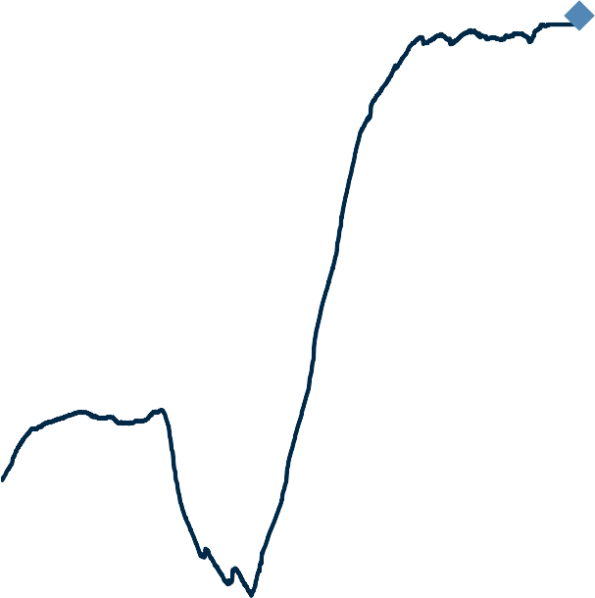
EARNINGS ARE LIKELY TO TREAD WATER
HEADWINDS FOR EARNINGS OVER THE NEXT 12 MONTHS
Top-Line Sales Move With Nominal Earnings
Margins Come Under Pressure During Recession
Earnings to Tread Water in 2024
2023:
$220
2024:
$220
30%
16
225
25%
14
215
20%
12
205
Sales Growth (%YoY)
15%
10
195
10%
8
185
6
175
5%
4
165
0%
2
155
-5%
0
145
-10%
Annual Nominal GDP Forecast
-5% 0% 5% 10%
Nominal GDP (%YoY)
-2
135
-15%
-10%
-4
15% 20%
1Q03 1Q05 1Q07 1Q09 1Q11 1Q13 1Q15 1Q17 1Q19 1Q21 1Q23
Recession S&P 500 Net Margin
125
2018
2019 2020 2021 2022
S&P 500 - Earnings per Share
2023
Forecast
2024
Source: FactSet, Data as of 9/30/2023.

Slide 29



CHOPPY WATERS FOR EQUITY MARKET IN NEAR TERM
NEAR-TERM HEADWINDS LIKELY TO LEAD TO CHOPPY WATERS FOR EQUITY MARKET
Corporate Activity (e.g., Buybacks) Slowing
4.00
Equities No Longer As Attractive vs. Bonds
300
275
250
225
200
175
150
125
100
4,400
Year-End 2023
S&P 500 Target
3.00
2.00
1.00
4,650
12-Month
S&P 500 Target
0.00
75
50
25
0
-1.00
-2.00
1Q13 1Q14 1Q15 1Q16 1Q17 1Q18 1Q19 1Q20 1Q21 1Q22 1Q23
S&P 500 Quarterly Buybacks (in $bn)
2003
2007 2011 2015 2019
10-Year US Treasury Yield Less S&P 500 Dividend Yield
2023
Source: FactSet, Data as of 9/30/2023.

Slide 30
WHY WE REMAIN OPTIMISTIC LONGER TERM ON THE EQUITY MARKET
WE REMAIN OPTIMISTIC ON THE EQUITY MARKET LONGER TERM
Five Winds in the Equity Market Sails Longer Term
Return Following Recession Leads to Upside
Longer Term
End of Recession
1
Macro Factors (Final Fed Rate Hike,
Falling Interest Rates) Supportive
115
110
2
Markets Typically Rally Following Recession
105
3
Still in Early Stages of Bull Market Voyage
100
95
4
Record Amount of Cash On Sidelines
90
5
Subdued Investor Sentiment
85
-261 -221 -181 -141 -101 -61 -21 19 59 99 139 179 219 259
Average S&P 500 Performance Surrounding End of Recession (indexed to end of recession)
Source: FactSet, Data as of 9/30/2023.

Slide 31


SECTOR SPOTLIGHT
BUILDING THE FLEET OF OUR FAVORITE SECTORS
Info
Tech
Health
Care
Financials
Energy
Should benefit from long-term trend in AI
Highest margins of any sector
Consistently beat earnings estimates
Well-diversified business strategy of mega-cap companies
Trading at discount to historical average
Trades well in sprints and climbs
Aging demographics
Historically strong earnings and revenue growth (good visibility)
Loan growth stabilizing
Healthy EPS and revenue growth
Corporate activity picking up
Oversold sentiment a positive
Healthy stress tests = increased dividends and buybacks
Highest dividend + buyback yield of any sector
Elevated oil prices
Continued investment in green energy
Increased capital discipline

Slide 32

LOOKING INTO OUR FAVORITE SECTORS
VALUATIONS AND POSITIONING ARE A FEW REASONS WHY WE LIKE OUR FAVORITE SECTORS
Valuations Attractive in Our Favorite Sectors
Tech the Largest Underweight Relative to
Current Market Cap of Any Sector
50%
40%
30%
20%
10%
0%
-10%
-20%
-30%
-40%
-50%
0
7.2%
Magnitude Of Tech
Earnings Beats Vs.
Expectations—the Most
Of Any Sector Over Last
Ten Years
-0.01
-0.02
-0.03
-0.04
-0.05
-0.06
-0.07
-0.08
Utilities Real Estate Energy Cons Disc Info Tech
Average Weighting in Top 100 Mututal Funds Relative to S&P 500 Weight
Current PE Relative to S&P 500
20-Year Average
Source: FactSet, Data as of 9/30/2023.

Slide 33



FAVOR THE US OVER DEVELOPED MARKETS
CONTINUE TO FAVOR THE US OVER INTERNATIONAL DEVELOPED MARKETS; OPPORTUNITIES ARISING IN EMERGING MARKETS
US Earnings Outpace Global
Counterparts
Five Reasons We See Opportunities in
Emerging Markets
Peak China Pessimism?
10%
9%
8%
7%
6%
5%
4%
3%
2%
1%
0%
1
Macro Factors (Final Fed Rate Hike, Falling Interest Rates) Supportive
Falling Inflation Supportive of EM Starting Rate Cuts
2
3
Still in Early Stages of Bull Market Voyage
4
India and Mexico to Benefit from
Friendshoring
S&P 500 MSCI Europe MSCI EAFE MSCI Japan
5-Year Annualized EPS Growth (2019-2024)
5
Peak China Pessimism?
Source: FactSet, Data as of 9/30/2023.

Slide 34

INSIGHT:
Similar to Jimmy Buffett’s famous songs, visiting ‘Margaritaville’ and ‘Enjoying a Cheeseburger in Paradise’ is the goal of every long-term investor.
7
Asset Allocation
Preparing to Enjoy Margaritaville
BOTTOM LINE:
A balanced, well-rounded, and consistent long-term focused strategy is essential. Focus on diversification
and asset allocation to help get you across your finish line.
34

Slide 35
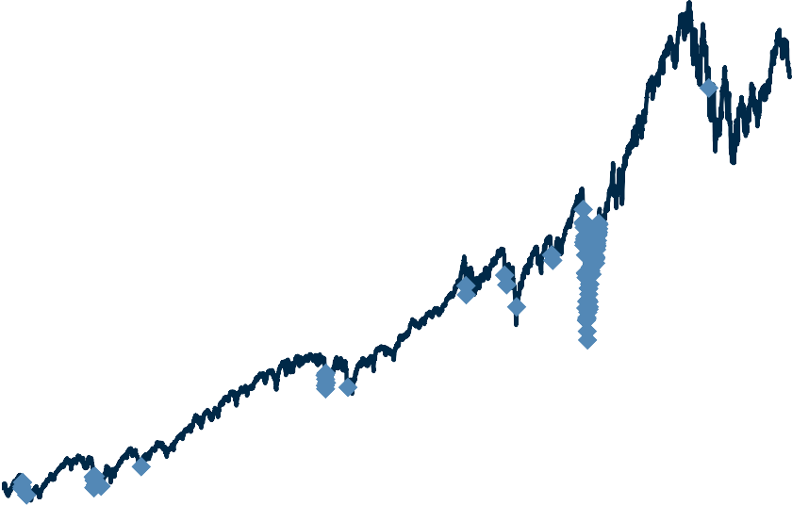
STICK TO INVESTING STRATEGY
OUTSIZED POSITIVE MARKET RETURNS OFTEN FOLLOW NEGATIVE EQUITY INVESTOR FLOWS
Market Typically Performs Better Following Months of Outflows
Positive Performance Following ‘Markets in Turmoil’
5%
4.71%
5,250
1-Year Average Return Following Markets in Turmoil Special
+38%
4,750
4%
“Be fearful when others are greedy and greedy when others are fearful.”
-Warren Buffett
4,250
105/106 Times
99%
% of Time Positive 1- Year Later
3%
3,750
2%
1.93%
3,250
2,750
1%
2,250
0%
1,750
-1%
1,250
Return During Month of Flow (Avg)
Next Month Return (Avg)
3 Month Return (Avg)
750
2009 2011 2013
S&P 500 - Price Index
2015 2017 2019 2021
CNBC 'Markets in Turmoil' Special
After Month of Equity Outflow After Month of Equity Inflow
Source: FactSet (ETF US Large Cap Equity Flows), Data from 2010-2023, Data as of 9/30/2023.
35

Slide 36




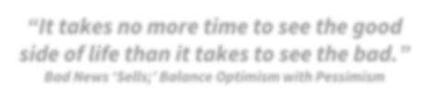

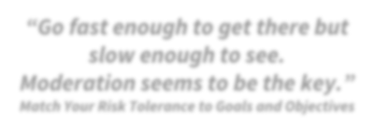


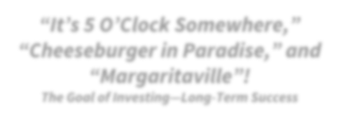

LESSONS FROM JIMMY BUFFETT
JIMMY BUFFETT TURNED MUSIC AND LIFESTYLE INTO A $1 BILLION EMPIRE
“Without geography
you’re nowhere.”
You Need to Have a Plan and Strategy
“It takes no more time to see the good
side of life than it takes to see the bad.”
Bad News ‘Sells;’ Balance Optimism with Pessimism
“Go fast enough to get there but
slow enough to see.
Moderation seems to be the key.”
Match Your Risk Tolerance to Goals and Objectives
“I can’t change the direction of the wind, but I can adjust my sails to always reach my destination.”
Monitor Your Progress; Make Adjustments as Needed
“Breathe in, breathe out, move on...” “Quitting doesn’t enter my mind.”
Do Not Panic, Keep to Your Long-Term Plan
“It’s 5 O’Clock Somewhere,” “Cheeseburger in Paradise,” and “Margaritaville”!
The Goal of Investing—Long-Term Success
— Jimmy Buffett

Slide 37
Nov 6 | 4:00 pm E.T.
UPCOMING WEBINARS
Market Outlook and Timely Investment Topics
This presentation will discuss recent market and economic trends and impacts.

Slide 38


SOCIAL MEDIA
FOLLOW OUR CIO ON TWITTER
FOLLOW OUR CIO ON LINKEDIN
@LARRYADAMRJ
Larry Adam

Slide 39

FOLLOW RAYMOND JAMES ON TWITTER
SOCIAL MEDIA
@RAYMONDJAMES

Slide 40
INVESTMENT STRATEGY GROUP
 | Eugenio J. Alemán, PhD Senior Vice President, Chief Economist T.727.567.2603 eugenio.aleman@raymondjames.com Matt Barry, CFA Investment Strategy Analyst T. 410. 525. 6228 matt.barry@raymondjames.com Matthew Ziyadeh, CFA, CIPM® Investment Strategy Analyst T. 727. 567. 8984 matthew.kurayaziyadeh@raymondjames.com | Lawrence V. Adam III, CFA, CIMA®, CFP® Chief Investment Officer T. 410.525.6217 larry.adam@raymondjames.com Matt Hanna, CFA, FRM, CAIA Director, Asset Alloc. & Quant. Strategy T. 727.567.4978 matt.hanna@raymondjames.com Giampiero Fuentes, CFP® Economist T. 727.567.5776 giampiero.fuentes@raymondjames.com Tracey Manzi, CFA Senior Investment Strategist T. 727.567.2211 tracey.manzi@raymondjames.com Talley Léger Senior Equity Strategist T. 410.525.6228 talley.leger@raymondjames.com | Anne B. Platt, AWMA®, AIF®, RICP® VP, Investment Strategy T. 727.567.2190 anne.platt@raymondjames.com Michael Payne Investment Strategy Analyst T. 410. 525. 6232 mike.payne@raymondjames.com Lindsay Smith Investment Strategy Analyst T. 727.567.3335 lindsay.smith@raymondjames.com
40

Slide 41
DISCLOSURES
The views expressed in this commentary are the current opinion of the Chief Investment Office, but not necessarily those of Raymond James & Associates, and are subject to change. Information contained in this report was received from sources believed to be reliable, but accuracy is not guaranteed. Past performance is not indicative of future results. No investment strategy can guarantee success. There is no assurance any of the trends mentioned will continue or that any of the forecasts mentioned will occur. Economic and market conditions are subject to change. Investing involves risks including the possible loss of capital. Material is provided for informational purposes only and does not constitute a recommendation. Asset allocation do not ensure a profit or protect against a loss. Diversification and asset allocation do not ensure a profit or protect against a loss. Dollar-cost averaging cannot guarantee a profit or protect against a loss, and you should consider your financial ability to continue purchases through periods of low price levels.
INTERNATIONAL INVESTING | International investing involves additional risks such as currency fluctuations, differing financial accounting standards, and possible political and economic instability. These risks are greater in emerging markets. Investing in emerging markets can be riskier than investing in well-established foreign markets.
SECTORS | Sector investments are companies engaged in business related to a specific economic sector and are presented herein for illustrative purposes only and should not be considered as the sole basis for an investment decision. Sectors are subject to fierce competition and their products and services may be subject to rapid obsolescence. There are additional risks associated with investing in an individual sector, including limited diversification.
OIL | Investing in oil involves special risks, including the potential adverse effects of state and federal regulation and may not be suitable for all investors.
WEST TEXAS INTERMEDIATE | West Texas Intermediate can refer to a grade or a mix of crude oil, and/or the spot price, the futures price, or the assessed price for that oil; colloquially WTI usually refers to the price of the New York Mercantile Exchange WTI Crude Oil futures contract or the contract itself.
CURRENCIES | Currencies investing are generally considered speculative because of the significant potential for investment loss. Their markets are likely to be volatile and there may be sharp price fluctuations even during periods when prices overall are rising.
GOLD | Gold is subject to the special risks associated with investing in precious metals, including but not limited to: price may be subject to wide fluctuation; the market is relatively limited; the sources are concentrated in countries that have the potential for instability; and the market is unregulated.
FIXED INCOME | Fixed-income securities (or “bonds”) are exposed to various risks including but not limited to credit (risk of default of principal and interest payments), market and liquidity, interest rate, reinvestment, legislative (changes to the tax code), and call risks. There is an inverse relationship between interest rate movements and fixed income prices. Generally, when interest rates rise, fixed income prices fall and when interest rates fall, fixed income prices generally rise.
US TREASURIES | US Treasury securities are guaranteed by the US government and, if held to maturity, generally offer a fixed rate of return and guaranteed principal value.
US TREASURY INDEX | An index based on recent auctions of US Treasury bills and is commonly used as a benchmark when determining interest rates, such as mortgage rates.
CAPEX | CAPEX Capital Expenditures are funds used by a company to acquire, upgrade, and maintain physical assets such as property, plants, buildings, technology, or equipment. CapEx is often used to undertake new projects or investments by a company.
FIXED INCOME DEFINITION
AGGREGATE BOND | Bloomberg US Agg Bond Total Return Index: The index is a measure of the investment grade, fixed-rate, taxable bond market of roughly 6,000 SEC-registered securities with intermediate maturities averaging approximately 10 years. The index includes bonds from the Treasury, Government-Related, Corporate, MBS, ABS, and CMBS sectors.
HIGH YIELD | Bloomberg US Corporate High Yield Total Return Index: The index measures the USD-denominated, high yield, fixed-rate corporate bond market. Securities are classified as high yield if the middle rating of Moody’s, Fitch and S&P is Ba1/BB+/BB+ or below.
CREDIT | Bloomberg US Credit Total Return Index: The index measures the investment grade, US dollar-denominated, fixed-rate, taxable corporate and government related bond markets. It is composed of the US Corporate Index and a non-corporate component that includes foreign agencies, sovereigns, supranationals and local authorities.
US DOLLAR | The U.S. Dollar Index is an index (or measure) of the value of the United States dollar relative to a basket of foreign currencies, often referred to as a basket of U.S. trade partners' currencies. The Index goes up when the U.S. dollar gains "strength" (value) when compared to other currencies.
200 DAY MOVING AVERAGE | The 200-day moving average is a popular technical indicator which investors use to analyze price trends. It is simply a security's average closing price over the last 200 days.

Slide 42
US INDEXES AND EQUITY SECTORS DEFINITION
S&P 500 | The S&P 500 Total Return Index: The index is widely regarded as the best single gauge of large-cap U.S. equities. There is over USD 7.8 trillion benchmarked to the index, with index assets comprising approximately USD 2.2 trillion of this total. The index includes 500 leading companies and captures approximately 80% coverage of available market capitalization.
RUSSELL 2000 | Russell 2000 Total Return Index: This index covers 2000 of the smallest companies in the Russell 3000 Index, which ranks the 3000 largest US companies by market capitalization. The Russell 2000 represents approximately 10% of the Russell 3000 total market capitalization. This index includes the effects of reinvested dividends.
INTERNATIONAL EQUITY DEFINITION
EMERGING MARKETS EASTERN EUROPE | MSCI EM Eastern Europe Net Return Index: The index captures large- and mid-cap representation across four Emerging Markets (EM) countries in Eastern Europe. With
50 constituents, the index covers approximately 85% of the free float-adjusted market capitalization in each country.
EMERGING MARKETS | MSCI Emerging Markets Net Return Index: This index consists of 23 countries representing 10% of world market capitalization. The index is available for a number of regions, market segments/sizes and covers approximately 85% of the free float-adjusted market capitalization in each of the 23 countries.
MSCI EAFE | The MSCI EAFE (Europe, Australasia, and Far East) is a free float-adjusted market capitalization index that is designed to measure developed market equity performance, excluding the United States & Canada. The EAFE consists of the country indices of 22 developed nations.
GERMAN BUND | A bund is a debt security issued by Germany's federal government, and it is the German equivalent of a U.S. Treasury bond.
SMALL CAP | Investing in small-cap stocks generally involves greater risks, and therefore, may not be appropriate for every investor. The prices of small company stocks may be subject to more volatility than those of large company stocks.
LARGE-CAP STOCK | also known as big caps are shares that trade for corporations with a market capitalization of $10 billion or more. Large-cap stocks tend to be less volatile during rough markets as investors fly to
quality and stability and become more risk-averse
MSCI AC WORLD EX-US | The MSCI AC ex USA Index captures large and mid cap representation across 22 of 23 Developed Markets (DM) countries (excluding the US) and 26 Emerging Markets (EM) countries*. With 2,215 constituents, the index covers approximately 85% of the global equity opportunity set outside the US.
LATAM | MSCI EM Latin America Net Return Index: The index captures large- and mid-cap representation across five Emerging Markets (EM) countries in Latin America. With 116 constituents, the index covers approximately 85% of the free float-adjusted market capitalization in each country.
ASIA EX-JAPAN | MSCI Pacific Ex Japan Net Return Index: The index captures large- and mid-cap representation across four of 5 Developed Markets (DM) countries in the Pacific region (excluding Japan). With 150 constituents, the index covers approximately 85% of the free float-adjusted market capitalization in each country.
JAPAN | MSCI Japan Net Return Index: The index is designed to measure the performance of the large and mid cap segments of the Japanese market. With 319 constituents, the index covers approximately 85% of the free float-adjusted market capitalization in Japan.
COMMODITIES DEFINITION
BLOOMBERG COMMODITY INDEX | Bloomberg Commodity Index is a commodity group sub index of the Bloomberg CITR. The index is composed of futures contracts on crude oil, heating oil, unleaded gasoline and natural gas. It reflects the return on fully collateralized futures positions and is quoted in USD.
WTI | West Texas Intermediate can refer to a grade or a mix of crude oil, and/or the spot price, the futures price, or the assessed price for that oil; colloquially WTI usually refers to the price of the New York Mercantile Exchange WTI Crude Oil futures contract or the contract itself.
BLOOMBERG EMERGING MARKETS AGGREGATE BOND INDEX | The Bloomberg s Emerging Markets Aggregate Bond Index is a flagship hard currency Emerging Markets debt benchmark that includes USD- denominated debt from sovereign, quasi-sovereign, and corporate EM issuers.
ZILLOW OBSERVED RENT INDEX | A measure of the typical home value and market changes across a given region and housing type. It reflects the typical value for homes in the 35th to 65th percentile range. Available as a smoothed, seasonally adjusted measure and as a raw measure.

Slide 43
ADOBE DIGITAL PRICE INDEX | The Digital Price Index is the most comprehensive measure of inflation in the digital economy, and it’s made possible by the ability of Adobe Analytics to turn terabytes of data into
useable insights.
NAR HOUSING AFFORDABILITY INDEX | The Housing Affordability Index measures whether or not a typical family earns enough income to qualify for a mortgage loan on a typical home at the national and regional levels based on the most recent price and income data.
COX AUTOMOTIVE INDEX | The Cox Automotive/Moody's Analytics Vehicle Affordability Index measures the ability of a household earning the median income to afford the purchase of an average-priced automobile.
INTERNATIONAL DISCLOSURES
FOR CLIENTS IN THE UNITED KINGDOM | For clients of Raymond James Financial International Limited (RJFI): This document and any investment to which this document relates is intended for the sole use of the persons to whom it is addressed, being persons who are Eligible Counterparties or Professional Clients as described in the FCA rules or persons described in Articles 19(5) (Investment professionals) or 49(2) (high net worth companies, unincorporated associations, etc.) of the Financial Services and Markets Act 2000 (Financial Promotion) Order 2005 (as amended)or any other person to whom this promotion may lawfully be directed. It is not intended to be distributed or passed on, directly or indirectly, to any other class of persons and may not be relied upon by such persons and is, therefore, not intended for private individuals or those who would be classified as Retail Clients. FOR CLIENTS OF RAYMOND JAMES INVESTMENT SERVICES, LTD.: This document is for the use of professional investment advisers and managers and is not intended for use by clients. FOR CLIENTS IN FRANCE | This document and any investment to which this document relates is intended for the sole use of the persons to whom it is addressed, being persons who are Eligible Counterparties or Professional Clients as described in "Code Monetaire et Financier" and Reglement General de l'Autorite des marches Financiers. It is not intended to be distributed or passed on, directly or indirectly, to any other class of persons and may not be relied upon by such persons and is, therefore, not intended for private individuals or those who would be classified as Retail Clients. FOR CLIENTS OF RAYMOND JAMES EURO EQUITIES | Raymond James Euro Equities is authorised and regulated by the Autorite de Controle Prudentiel et de Resolution and the Autorite des Marches Financiers. FOR INSTITUTIONAL CLIENTS IN THE EUROPEAN ECONOMIC AREA (EE) OUTSIDE OF THE UNITED KINGDOM | This document (and any attachments or exhibits hereto) is intended only for EEA institutional clients or others to whom it may lawfully be submitted. FOR CANADIAN CLIENTS | This document is not prepared subject to Canadian disclosure requirements, unless a Canadian has contributed to the content of the document. In the case where there is Canadian contribution, the document meets all applicable IIROC disclosure requirements.
DESIGNATIONS
Certified Financial Planner Board of Standards Inc. owns the certification marks CFP® and CERTIFIED FINANCIAL PLANNER™ in the U.S.
Investments & Wealth InstituteTM (The Institute) is the owner of the certification marks “CIMA” and “Certified Investment Management Analyst.” Use of CIMA and/or Certified Investment Management Analyst signifies that the user has successfully completed The Institute's initial and ongoing credentialing requirements for investment management professionals.
CFA® and Chartered Financial Analyst® are registered trademarks owned by CFA Institute. DATA SOURCES:
FactSet.

Slide 44
INTERNATIONAL HEADQUARTERS: THE RAYMOND JAMES FINANCIAL CENTER
880 CARILLON PARKWAY // ST. PETERSBURG, FL 33716 // 800.248.8863 RAYMONDJAMES.COM
Investment products are: not deposits, not FDIC/NCUA insured, not insured by any government agency, not bank guaranteed, subject to risk and may lose value.
© 2023 Raymond James & Associates, Inc., member New York Stock Exchange/SIPC. © 2023 Raymond James Financial Services, Inc., member FINRA/SIPC. Raymond James® is a registered trademark of Raymond James Financial, Inc.

