Slide 1
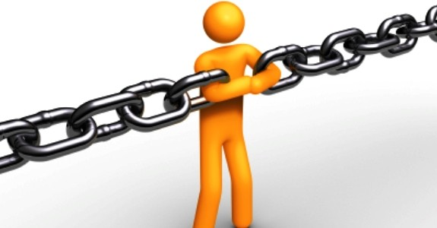

All Industry Day 2021
Save the
Date!
STRONG CONNECTIONS
This Photo by Unknown Author is licensed under CC BY-SA-NC
WHEN: August 26 and 27, 2021
WHERE: Virtual—no need to travel
WHO: Dynamic speakers and CE credit
HOW: Early bird registration, $20
After August 1, $25

