Slide 1
Economic and financial risk in a post-pandemic environment
An Mines
VP, Financial Risk Management
USAA

Slide 2
Macroeconomic Trivia
ECONOMIC AND FINANCIAL RISK IN A POST-PANDEMIC ENVIRONMENT
  How much stimulus has been deployed since 2020?
        $500B - $1T
        $1T – 3T
        $5T – 7T
        $30T – 32T

Slide 3
Macroeconomic Trivia
ECONOMIC AND FINANCIAL RISK IN A POST-PANDEMIC ENVIRONMENT
      Since May 2020, auto insurance prices have increased by:
        <10%
        10 – 20%
        40 – 50%
        100 – 150%

Slide 4
Macroeconomic Trivia
ECONOMIC AND FINANCIAL RISK IN A POST-PANDEMIC ENVIRONMENT
  After breaching the 5% threshold in 1956, how many years did it take before mortgage rates fell below 5% again?
        12 years
        25 years
        34 years
        52 years

Slide 5
Inflation Reached 40-year Highs Last Year and Remains Elevated
ECONOMIC AND FINANCIAL RISK IN A POST-PANDEMIC ENVIRONMENT
Continued underlying price pressures
Consumer price inflation surged to 40-year highs in ‘21 and ’22, in the wake of the economic recovery from the Pandemic
As industrial activity gradually slows down across the globe, energy prices and good prices are moderating somewhat
Services inflation is a more sticky component, with continued wage pressure due to labor shortages and rising cost of living
Inflation still remains well above the Federal Reserve’s 2% target, as illustrated by the 3.7% annual rate in August
Source: Bureau of Labor Statistics

Slide 6
Root Cause of Inflation
ECONOMIC AND FINANCIAL RISK IN A POST-PANDEMIC ENVIRONMENT
Unprecedented fiscal and monetary stimulus
U.S. federal government deficit reached levels not seen since World War II during the pandemic, while the federal debt breached $32T in June of this year
The fiscal stimulus was complemented by zero percent interest rates and unprecedented quantitative easing, with the first interest rate hike occurring in March of last year
The average growth rate of the money supply (over the past 3 years) is significantly higher than the average growth rate during the stagflationary period of the ’70s
1
1
2
3
2
3
Source: U.S. Treasury Department, Bureau of Economic Analysis, Board of Governors of the Federal Reserve System, Bloomberg

Slide 7
Forecasting Has Proven Difficult in High Inflation Environment
ECONOMIC AND FINANCIAL RISK IN A POST-PANDEMIC ENVIRONMENT
Unexpected inflation and interest rate hikes
The rapid increase in inflation has resulted in significant forecasting errors and planning difficulties, with Property and Casualty (P&C) insurance companies challenged by rising claims costs due to elevated input prices
The Fed’s monetary tightening campaign kicked off in March ‘22, with the Fed delivering 525 basis points of rate hikes through September ’23, outpacing market participants’ expectations of how high policy rates would go
Source: Federal Reserve and Bloomberg

Slide 8
Surging Money Supply and Bank Deposits
ECONOMIC AND FINANCIAL RISK IN A POST-PANDEMIC ENVIRONMENT
RAPID CHANGES TO deposits due to Trillions of stimulus dollars
Roughly $6T in economic stimulus during two administrations resulted in rapid money supply growth between ’20 and ‘22
Due to social distancing and lockdowns, most of the stimulus ended up as increased bank deposits, putting pressure on banks to find avenues to match the inflow of liabilities with assets of similar yield and duration
Deposit volumes are gradually declining since last Summer, as customers are leveraging savings for consumption and / or moving money to better-yielding accounts (such as money market funds)
Source: Federal Reserve

Slide 9
Banking Sector Under Pressure
ECONOMIC AND FINANCIAL RISK IN A POST-PANDEMIC ENVIRONMENT
Rising unrealized losses
The market value of investment securities has declined significantly as interest rates rise, with over $560B worth of unrealized losses by Q2 ‘23 among FDIC-insured banks, which can be compared with roughly $130B worth of gains in Q2 ‘20
Bank shares have not fully recovered from the financial turbulence this Spring, which signals that market confidence in the banking sector is still weaker than before the banking crisis
Source: Federal Deposit Insurance Corporation (FDIC), Standard and Poor’s

Slide 10



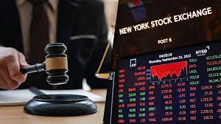
Inflationary Challenges to Insurance Companies
ECONOMIC AND FINANCIAL RISK IN A POST-PANDEMIC ENVIRONMENT
P&C
Rising auto and home repair costs, with risk of rising bodily injury costs and social inflation
Inability to change insurance rates in a timely manner due to state regulatory hurdles
LifeCo
Declining demand and rising policy lapses
Investment Portfolio
Higher interest rates lead to lower value of several investment securities
Falling equity prices have a negative impact on the broader company portfolio

Slide 11

What Macroeconomic Indicators and Risks are Important to You?
ECONOMIC AND FINANCIAL RISK IN A POST-PANDEMIC ENVIRONMENT

Slide 12
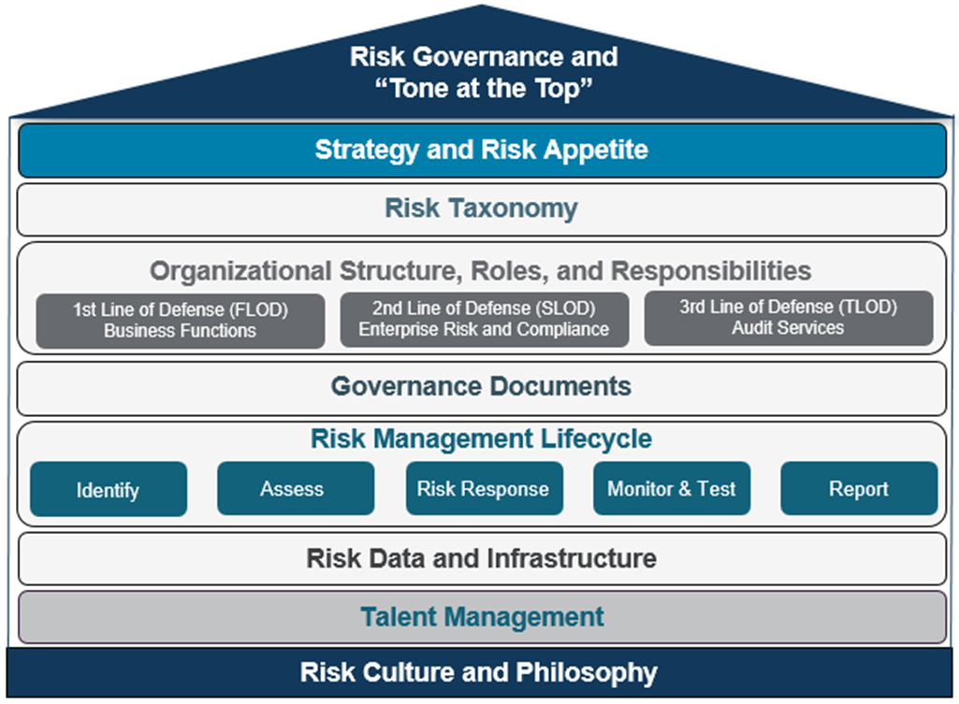
How Can P&C Insurance Companies Manage Macroeconomic Risk?
ECONOMIC AND FINANCIAL RISK IN A POST-PANDEMIC ENVIRONMENT
Risk Governance
It all starts with having a robust Enterprise Risk Management Framework (ERM) in place
Managing – not avoiding – Risk
Striking a balance between creating and protecting enterprise value
Proactive Risk Culture
Do not wait for a crisis to establish a sound risk management program

Slide 13
How Can P&C Insurance Companies Manage Macroeconomic Risk?
ECONOMIC AND FINANCIAL RISK IN A POST-PANDEMIC ENVIRONMENT
The risk management lifecycle within your ERM framework will allow you to manage any risks that comes your way. Specific areas of focus to manage Macroeconomic risks are shown below:
Risk identification | Risk monitoring | Scenario analysis | playbooks
Risk inventory Top and Emerging Risks | Risk Appetite Metrics Key Risk Indicators Early Warning Indicators | Stress Testing Scenario Analysis Sensitivity Analysis | Recession Monitoring Business Levers

Slide 14
Different Types of Scenario Analysis (“What If”)
ECONOMIC AND FINANCIAL RISK IN A POST-PANDEMIC ENVIRONMENT
PROS |  | CONS
Simple and fast |  | Less comprehensive
Flexible |  | Scenarios may not adequately capture risk
Integrated view of multiple risks |  | Complex and time consuming
SENSITIVITY ANALYSIS Examines the effect of changing a single variable at a time
2. SCENARIO ANALYSIS Assesses the effect of changing multiple variables at the same time
3. STRESS TESTING Worse case scenario where multiple risks materialize concurrently

Slide 15
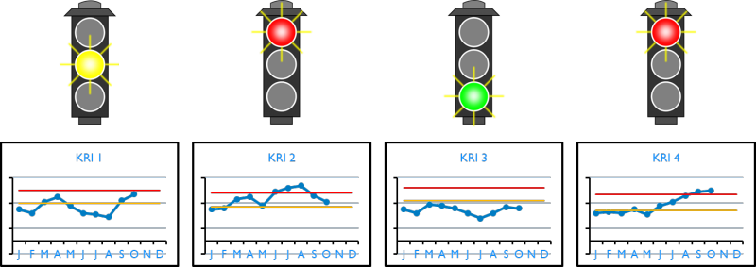
Monitoring Risk through Defined Thresholds
ECONOMIC AND FINANCIAL RISK IN A POST-PANDEMIC ENVIRONMENT

Slide 16

Conclusions
ECONOMIC AND FINANCIAL RISK IN A POST-PANDEMIC ENVIRONMENT
Macroeconomic environment remains volatile
Be prepared by having a robust Risk Management Framework
Run “what if” scenarios to help your company prepare
Monitor your specific risks through risk metrics
Control the controllable & be prepared to manage the uncontrollable

Slide 17
Thank you
An Mines
VP, Financial Risk Management
USAA

